Slide 1
MOBILE/LAPTOP SALE
REPORT BY-
PROJECT NO-26 |  | GROUP NO-26
NAME | REGISTRATION NO | ROLL NO | SECTION
HARSH RUHELA | 12105121 | RK21BGB72 | K21BG

Slide 2
DESCRIPTION
The entire project is a website related to webpages of sales of mobiles/laptops.
From the website anyone can purchase mobiles/laptops which are in sale.
For making this website I have used html and CSS .
CONCEPTS USED:-
1.) Basic html tags for making the structure of webpage.
2.) CSS selectors for styling the webpage.
3.)Flexbox.
4.)Media Query for adding some amount of responsiveness.

Slide 3
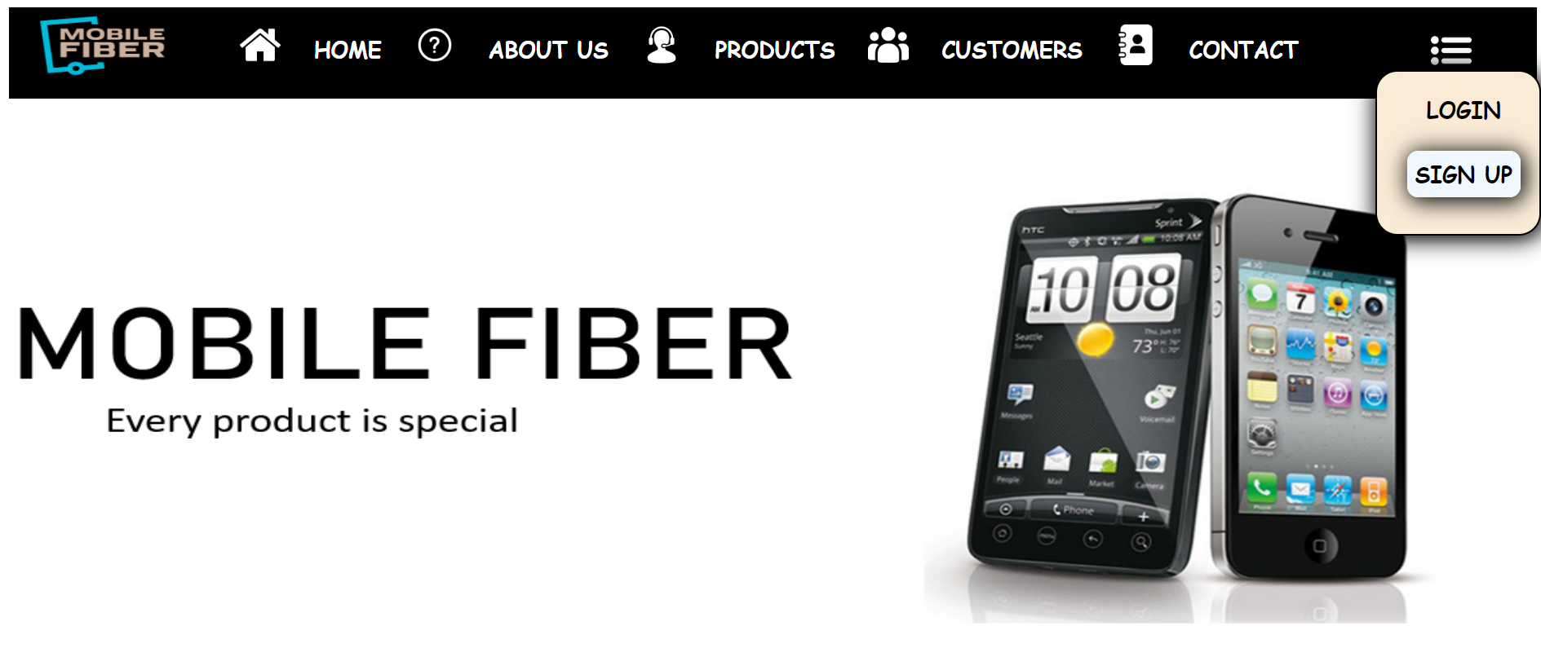
HOME
This is home page of my website .
From here you can see top deals on mobiles/laptops and you can purchase them.
You can login and sign up in the website .
Home page also gives description of the product quality ,shipping, and overall rating of company.
Tags used for making home page :- html, head, body, title, link, section, nav, div, img, li, a, ul, p, h1,iframe,button.

Slide 4
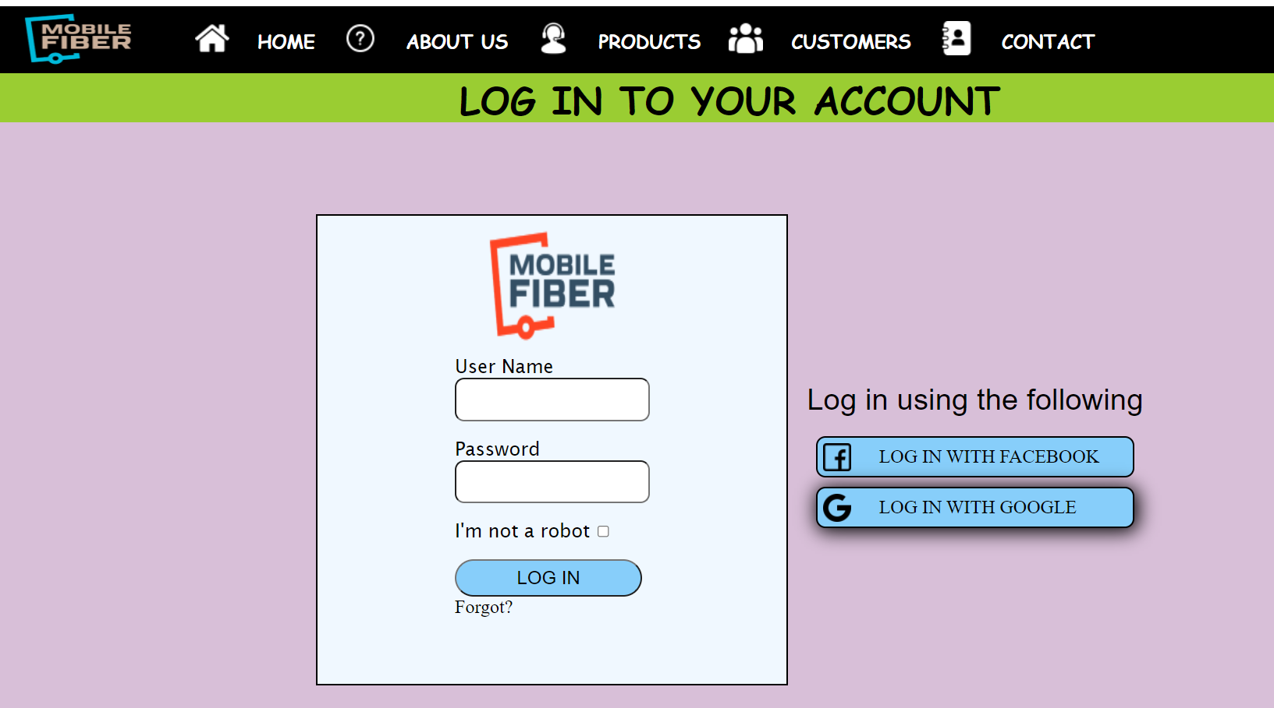
login
This is Login page of the website .
You can reach this page from the home page by clicking on three dots.
From this page you can login to the website.
Tags used for making login page :- html, head, body, title, link, nav, div, img, li, a, ul, p, h1,button, form, label, input.

Slide 5
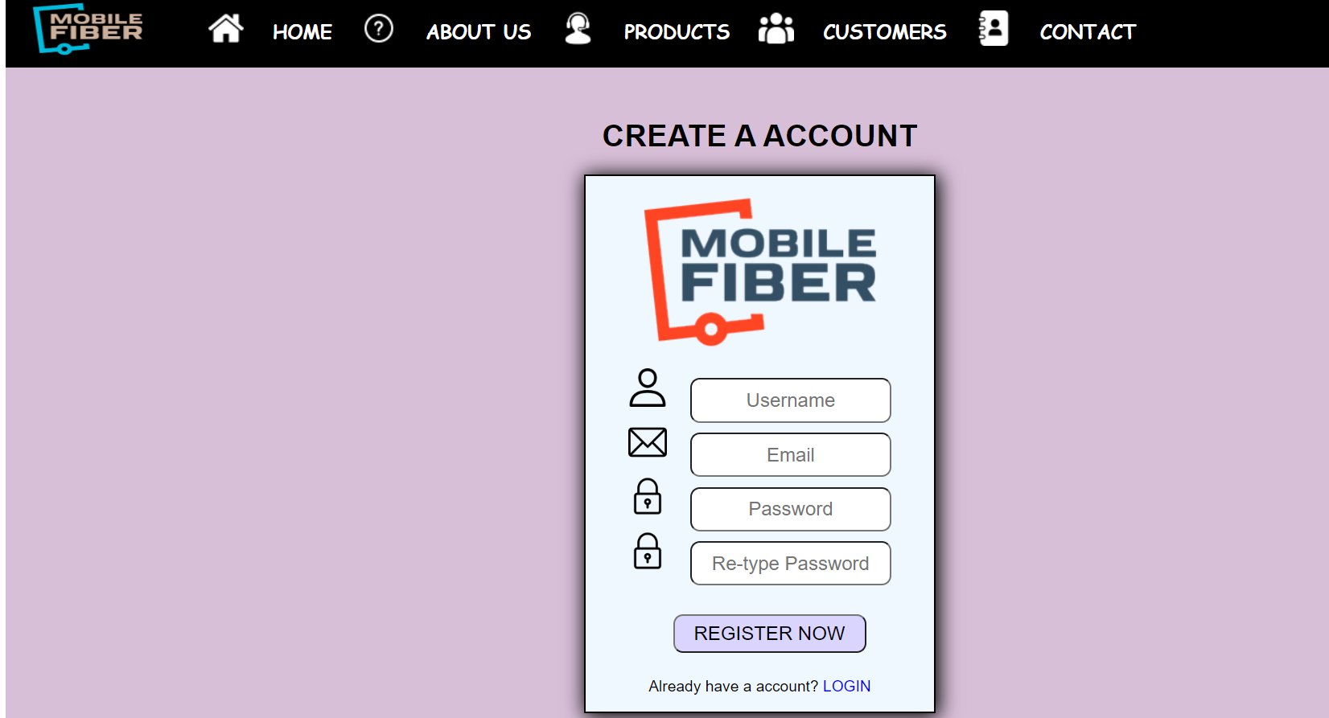
Sign up
This is the sign up page of the website.
You can reach this page from the home page by clicking on three dots.
From this page you can sign up to the website .
Tags used for making login page :- html, head, body, title, link, nav, div, img, li, a, ul, p, h1,button, form, label, input.

Slide 6
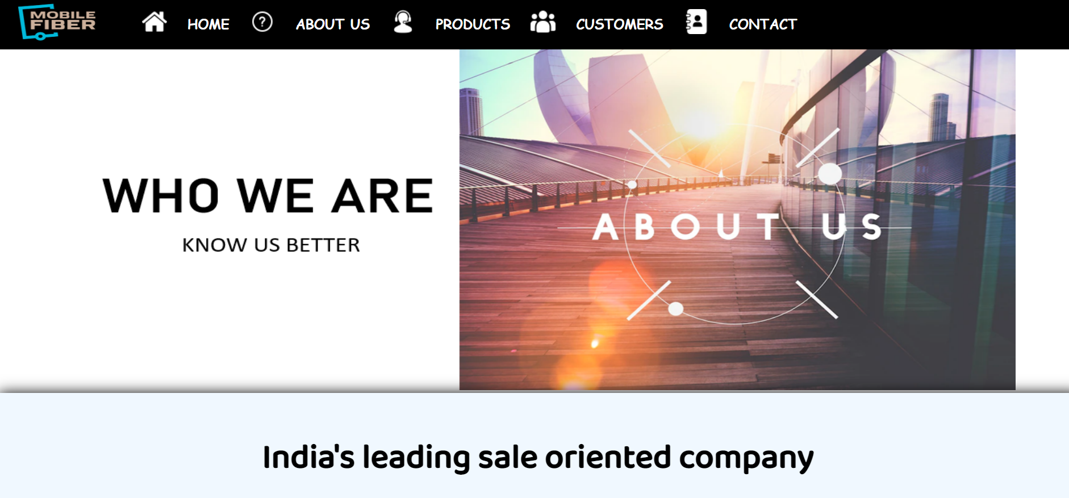
About us
This is the about us page of my website.
From here you can get to know the company better.
Tags used for making about us page:- html, head, body, title, link, header, section, nav, div, img, li, a, ul, p, h1,h2,h3,button.

Slide 7
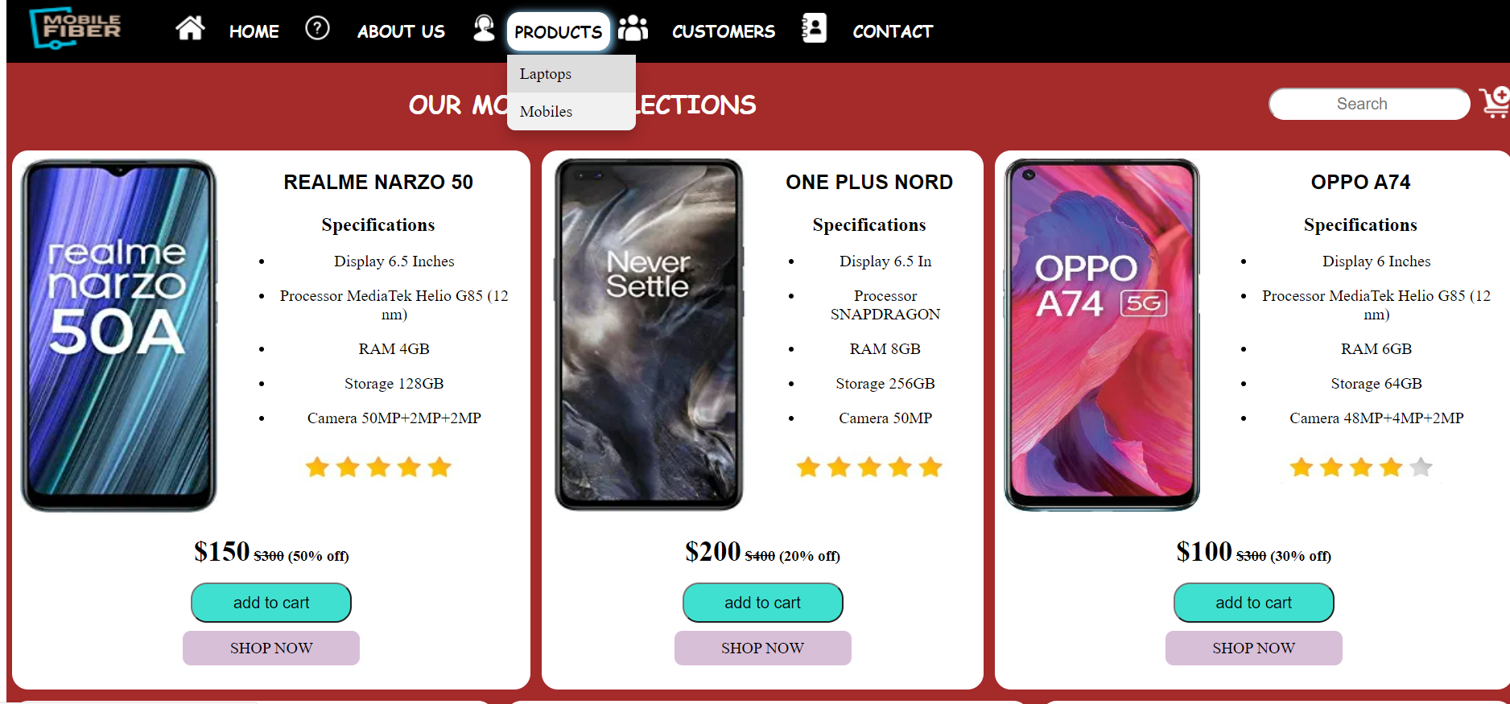
Products
This is the product page of the website.
It shows our mobile and laptop collection.
You can add the item to the cart and purchase it.
Tags used for making product page:- html, head, body, title, link, header, section, nav, div, img, li, a, ul, p, h1,h2,form ,input ,button.

Slide 8
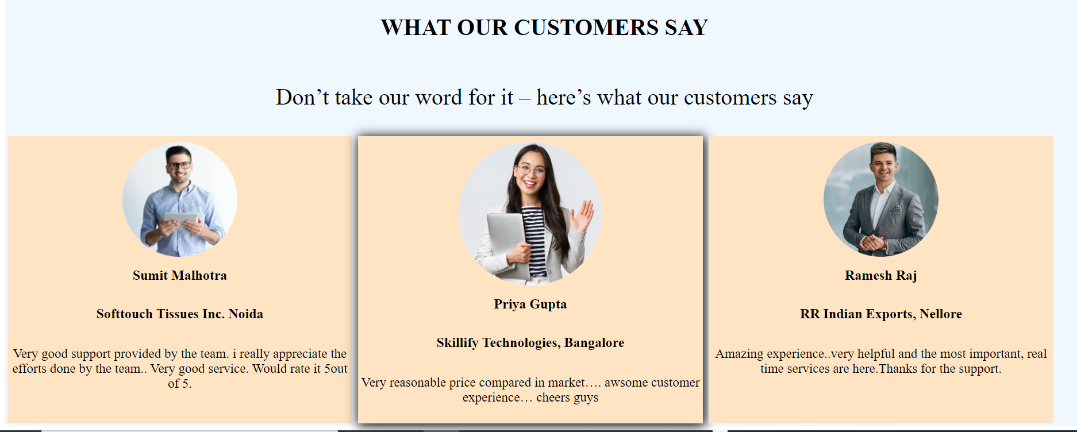
customers
This is the customer page of the website.
This page shows that what our customers say about us.
It contains reviews from our customers.
Tags used for making customer page:- html, head, body, title, link, header, section, nav, div, img, li, a, ul, p, h1 ,h2.

Slide 9
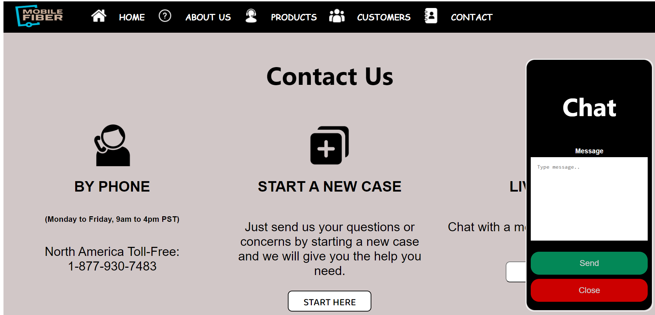
contact
This is the contact page of the website.
Anyone can contact us through this page.
You can contact through phone , start a case , can chat through chat window.
Tags used for making contact page:- html, head, body, title, link, header, section, nav, div, img, li, a, ul, p, h1 ,h2,button,label,form,textarea,script,table,tr,td,input

Slide 10
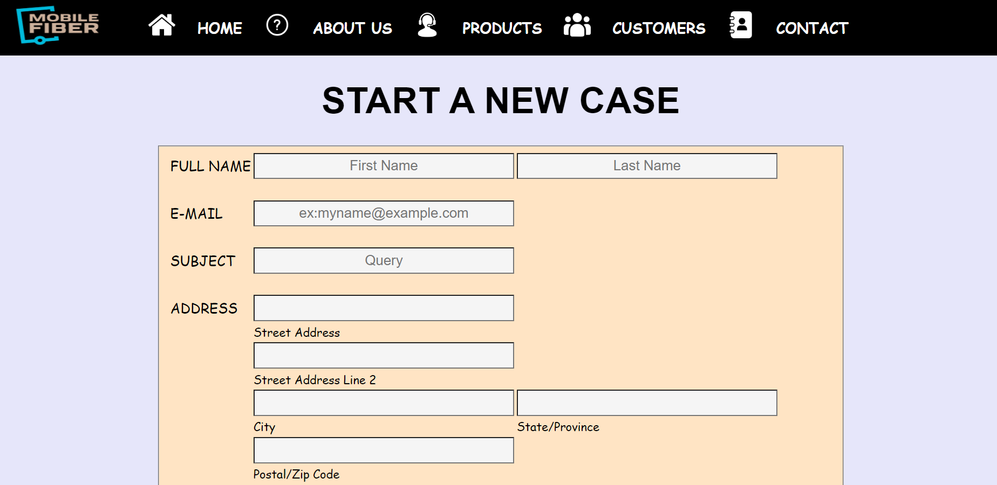
New case form
This is the new case page of the website.
In the contact page there is a option of starting a new case which takes you in this page.
You can send the questions ,concerns through this page.
Tags used:- html, head, body, link, title, div, nav, ul, li, a, fieldset,form, table, tr ,td, input, label, textarea,

